Slide 1
MHRN Mission
To improve the understanding and management of mental health conditions through a closer connection between research, practice, and policy.

Slide 2
MHRN History
Initial funding by 3-year cooperative agreement
  10 health systems and embedded research centers
  4 developmental projects
Now starting last year of 5-year cooperative agreement
  13 health systems and embedded research centers
  1 large pragmatic trial and 3 pilot projects
  12 active affiliated projects

Slide 3
Clinical / Public Health Focus Areas
Suicide prevention
Early intervention for SMI in children and youth
Reducing CV risk in people with SMI
Reducing racial/ethnic disparities in care
Personalized/precision medicine
Opioid use and misuse
Measurement-based mental health care

Slide 4
Methodologic range
Pragmatic clinical trials
Case/control epidemiologic studies
Cohort epidemiologic studies
Qualitative research
Biobanking/genomics
Implementation science
(Sample sizes range from 22 to 28,000,000)

Slide 5
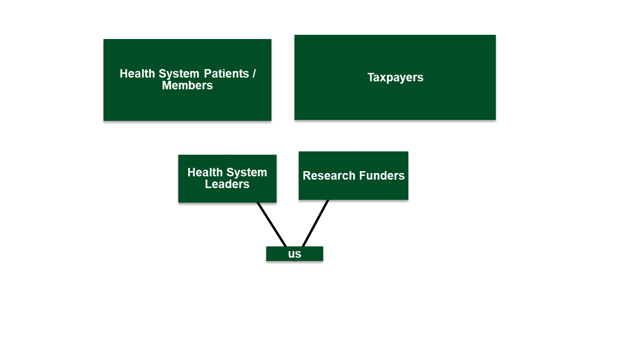
MHRN Organizational Chart

Slide 6
Site involvement in MHRN projects
 | BS&W | EIRH | HPHC | HPI | HFHS | KPCO | KPGA | KPHI | KPNC | KPNW | KPSC | KPWA | PAMF | External Sites
MHRN Infrastructure |  |  |  |  |  |  |  |  |  |  |  | LEAD
Treatment Utilization Before Suicide |  |  |  |  | LEAD
Population-Based Suicide Risk Calculator |  |  |  |  |  |  |  |  |  |  |  | LEAD
Safer Use of Antipsychotics in Youth |  |  |  |  |  |  |  |  |  |  |  | LEAD |  | Nationwide Childrens
Reducing CVD Risk in People with SMI |  |  |  | LEAD
First-Episode Psychosis in a Defined Population |  |  |  |  |  |  |  |  |  |  |  | LEAD
Pragmatic Trial of Suicide Prevention Outreach |  |  |  |  |  |  |  |  |  |  |  | LEAD
Practice Variation in Care of Mood Disorders |  |  |  |  |  |  |  |  |  |  |  | LEAD
Next-Generation Assessment via mHealth |  |  |  |  |  |  |  |  |  | LEAD |  |  |  | UCSF
Maximizing Biospecimen Collection in Youth |  |  |  |  |  |  |  |  | LEAD
Lethal Means Restriction in Pediatric Primary Care |  |  |  |  |  |  |  |  |  |  |  |  |  | LEAD - Univ. Penn.
Racial/Ethnic Disparities in Depression Treatment |  |  |  |  |  |  |  |  |  |  | LEAD
Behavioral Activation for Perinatal Depression |  |  |  |  |  | LEAD |  |  |  |  |  |  |  | Univ. Colorado & Emory
Automated Follow-up of Depression Treatment |  |  |  |  |  |  |  |  |  |  |  | LEAD
Population-Based Autism Registry |  |  |  |  |  |  |  |  | LEAD
Zero Suicide Implementation Across Health Systems |  |  |  |  | LEAD
ZS Implementation and Changes in Opioid Prescribing |  |  |  |  | LEAD
SSRI Warnings and Suicide Risk |  |  | LEAD
Gender Reassigment and Mental Health |  |  |  |  |  |  | LEAD |  |  |  |  |  |  | Dept of Veterans Affairs
Care of Mental Physical and Substance Use Syndromes |  |  |  | LEAD |  |  |  |  |  |  |  |  |  | Comm Hlth Plan Wash.
All of Us Research Program Trans-America Consortium |  |  |  |  | LEAD |  |  |  |  |  |  |  |  | Multiple external sites
Computational Modeling to Predict Suicide Behavior |  |  |  |  |  |  |  |  |  |  |  | LEAD
Computational Modeling of Doctor-Patient Communication |  |  |  |  |  |  |  |  |  |  |  |  | LEAD | Univ. of Utah
Effects of Medical Products on Suicidal Behavior |  |  |  |  |  |  |  |  |  |  |  | LEAD
Infrastructure and Methods for Feedback-Informed Care |  |  |  |  |  | LEAD
Opioids and Suicidal Behavior |  |  |  |  |  |  |  |  |  | LEAD
Identifying Lethal Means Restriction in EHRs |  |  |  |  |  | LEAD
Methods for Stakeholder Engagement |  |  |  |  |  |  |  |  |  |  | LEAD |  |  | Rand/UCLA

Slide 7
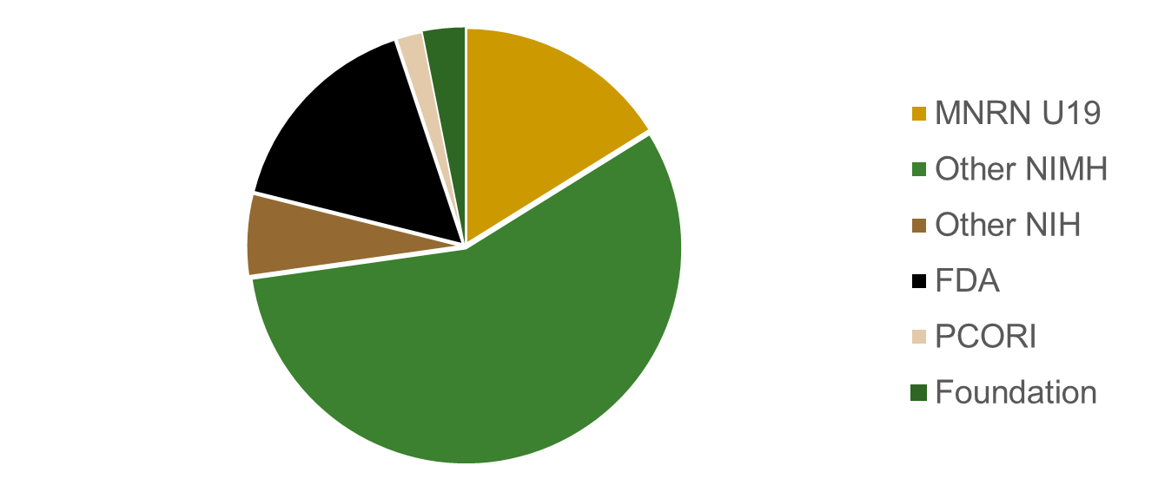
Total annual funding $12.4 million
Does not include $12 million NIH OD award for AllofUs consortium

Slide 8
MHRN Dissemination and communications
>80 peer-reviewed publications (BMJ, JGIM, JAMA Psychiatry, Am J Psychiatry, Am J Pub Health, J Clin Psychiatry)
Quarterly newsletters for researchers and health system leaders
MHRN website and blog

Slide 9
MHRN Impact – Suicide Prevention
Research on PHQ9 item 9 prediction of suicidal behavior widely implemented in MHRN and other health systems
Leading test-bed for suicide prevention quality metrics
Suicide prediction models to be “standard equipment” in Epic predictive analytics module (50% of US practices)
Collaboration with NCQA regarding quality measures for follow-up after ED encounter
Population-based outreach interventions - TBD

Slide 10
MHRN Impact – Reducing CVD risk in SMI
CV Wizard intervention under evaluation in cluster-randomized pragmatic trial
HealthPartners plans to implement in all practices at end of trial follow-up period

Slide 11
MHRN Impact – Reducing racial/ethnic disparities
Kaiser Permanente now reports race/ethnicity stratified HEDIS measures for depression care
New focus on cultural competence in prescribing of antidepressant medication

Slide 12
MHRN Impact – Measurement-based care
Adoption of standard outcome questionnaires (PH9 + GAD2 + Audit-C) across MHRN health systems
Collaboration with NCQA regarding ECDS depression care measures for adults and adolescents
Automated outreach pilot improves efficiency of depression care management – instant implementation at KPWA

Slide 13
MHRN Zero Suicide Evaluation
Title: An Evaluation of the National Zero Suicide Model Across Learning Healthcare Systems (U01MH114087).
Sites
  Henry Ford Health System (Ahmedani)
  KP Washington (Simon)
  KP Northwest (Bobbi Jo Yarborough / Frances Lynch)
  KP Southern California (Karen Coleman)
  KP Northern California (Stacy Sterling)
  KP Colorado (Arne Beck)
~9 million patients/members per year
All healthcare delivery settings / providers / clinics (PC, OP Med. Specialty, IP, ED, BH Specialty)

Slide 14
Zero Suicide Evaluation
*
Specific Aims:
  Develop / Optimize Data Metrics. Collaborate with health system leaders to develop EHR metrics to measure specific quality improvement targets and care processes tailored to local NZSM implementation. (Years 1-2)
  Evaluate Fidelity. Examine the fidelity of the specific NZSM care processes implemented in each system. (Years 2-4)
  Evaluate Suicide Outcomes. Investigate suicide attempt and mortality outcomes within and across NZSM system models. (Years 3-5).
    Aims 2-3: ITS and Stepped Wedge Designs across and within systems to measure fidelity/outcomes for the various implemented individual and bundled ZS approaches.

Slide 15
ZS Components
ZS ‘Operational’ Components (Aim 1 collaboration)
ZS ‘Clinical’ Components (Aim 1-3 measurement)
  Identify (PHQ-9, C-SSRS, other)
  Engage (Safety Plan, Follow-Up Contacts/Visits)
  Treat (Specialty Treatment)
  Transition (Post-Discharge follow-up, Caring Contacts, Visits after Referral)
Measurement tracking via the Electronic Health Record Systems (Epic), Insurance Claims, and Mortality Records.
  Established data sources in MHRN Virtual Data Warehouse.
  New ZS data sources in Epic/Claims.
  State and government mortality records.

Slide 16
ZS Project Highlights
Rapid response to unique opportunity.
  Informing SAMHSA, IHS, and other roll-outs.
  Informing quality standards – TJC, SAMHSA, NQF
  Evaluate individual components and bundles of components.
Engagement with large health systems in real-world implementation.
  Large influential health systems
Adequate scale to evaluate impact on suicide mortality.
  High priority in suicide prevention research.
Are we really bending the curve?
  MHRN has unique capability to measure processes and outcomes.

Slide 17



Firearm safety promotion in pediatric primary care as a universal suicide prevention strategy (R21)
Pre-implementation contextual inquiry of evidence-based practice for firearm safety prevention intervention
2 MHRN sites (HFHS, BSW)
Goal: Can we partner with health system stakeholders to understand how best to implement Firearm Safety Check as a universal suicide prevention strategy in pediatric primary care?

Slide 18
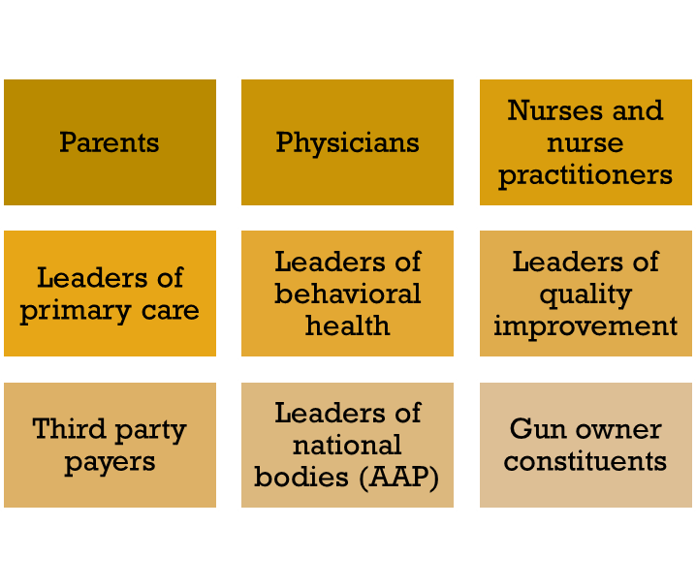
Quantitative – Aim 1
Qualitative – Aim 2
71 clinics (86%)
103 physicians (50%)
40 leaders of practices(70%)
4 papers; presentation at NASEM; R01 to be submitted in 2019

Slide 19
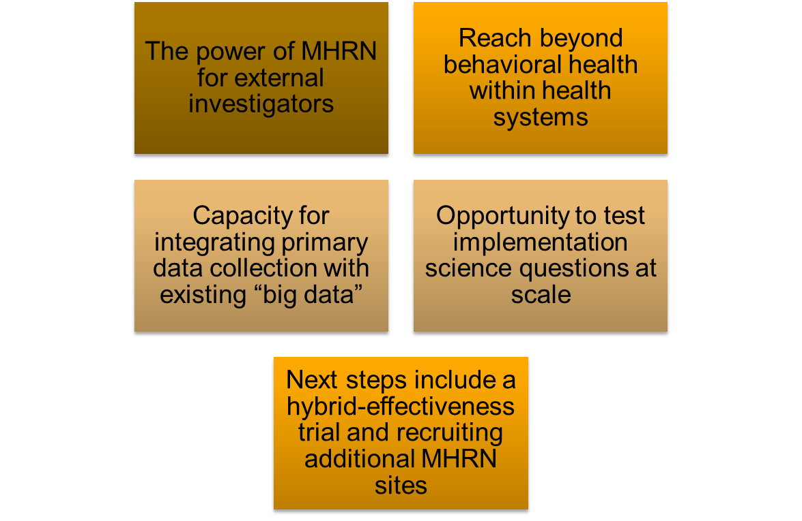
ASPIRE Highlights

Slide 20
Machine learning prediction of suicide risk
7 MHRN health systems with combined enrollment of 8 million
20 million visits by 4 million members aged 13 or older
  Mental health specialty visits
  General medical visits with mental health or substance use diagnosis
Linked to nonfatal suicide attempt or suicide death within 90 days
Approximately 150 potential predictors (and 200 possible interactions)
  Demographic characteristics (age, sex, race/ethnicity, SES)
  Current/recent/past mental health diagnoses
  Current/recent/past mental health medications
  Current/recent/past acute care utilization for mental health diagnosis
Prediction models developed in 65% sample, validated in 35%
Logistic model with penalized LASSO variable selection

Slide 21
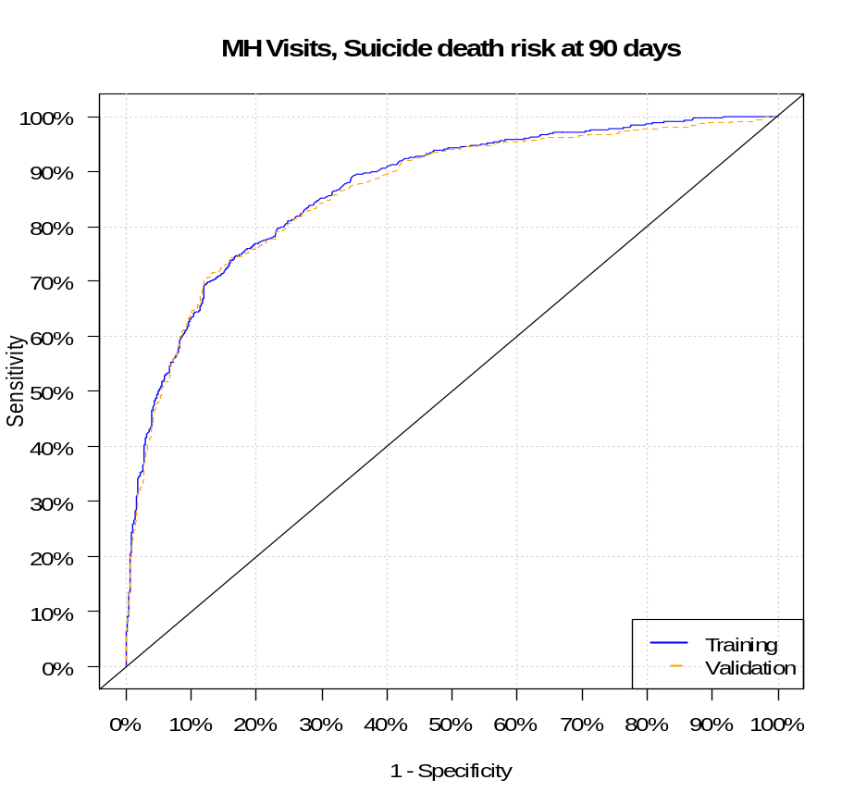
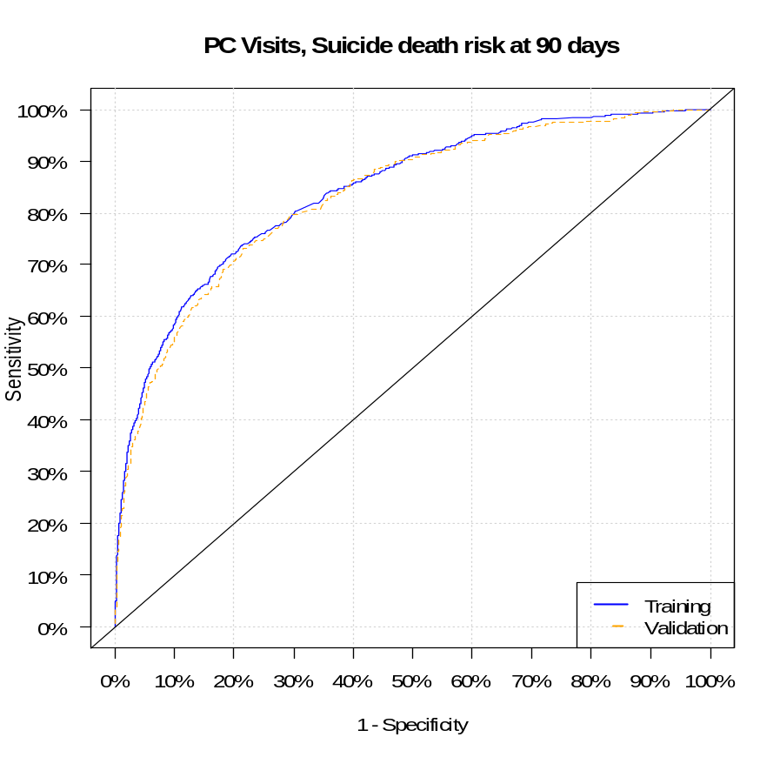
AUC=0.861 (0.845 - 0.877)
AUC=0.833 (0.813 - 0.853)

Slide 22
MHRN Suicide Risk Calculator Highlights
Substantially outperformed prior risk prediction efforts
Robust across health systems, race/ethnicity, and age
Models directly applicable to everyday practice
All tools and results in the public domain
Implementation underway in KP Washington and N. California regions
Soon available to all Epic users via new predictive analytics module
Powerful tool to advance research
  Selecting participants for next generation of pragmatic trials
  Account for confounding in observational studies of treatment effects
Next generation of models under development
  Expanded set of predictors, more detailed temporal encoding, 28 million visits
  Extend to ED encounters and Inpatient discharges
  New NIDA funding to add consideration of opioid related predictors and outcomes

Slide 23
Creating customized depression treatment
Goal: to provide evidence-based treatment strategies customized for an individual patient
  Adaptive treatment strategies (ATSs) evolve over time in response to changing patient characteristic, such as symptoms, side effects, and prior treatment response.
  Consider sequences of treatment decisions
Existing approaches that use data from randomized trials to estimate ATSs available
  Not feasible to conduct enough randomized trials
Notes:
Causal Inference in Dynamic Treatment Regimes (Susan)
Using big data to personalize treatment
Using machine learning methods for causal inference
Developing generalizable methods to address emerging questions
Really all about my R01

Slide 24
Leveraging MRHN data to customize care
Longitudinal information on individuals including treatment patterns, how patients responded to those treatment, and outcomes of interest
  Depressive symptoms, suicidal behavior, hospitalizations
MHRN has this information from the health records of thousands of individuals
  Contain much of the data providers are using to select care in real-life settings
Methods gaps must be addressed before we can use EHR data to estimate ATSs
Notes:
Causal Inference in Dynamic Treatment Regimes (Susan)
Using big data to personalize treatment
Using machine learning methods for causal inference
Developing generalizable methods to address emerging questions
Really all about my R01

Slide 25
Improving methods for estimating ATSs
IMATS will address current methods gaps to using EHR to customize depression care
  Machine learning approaches to select tailoring variables that should inform treatment selection
  Sensitivity analytic approaches to quantify impact unmeasured confounding has on estimated ATS
  Sample size formula accounting for observational nature of EHR data and sequential treatments

Slide 26
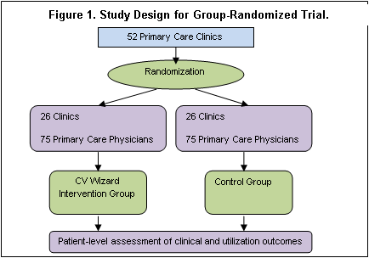
SMI Wizard: RCT to Reduce CV Risk
Cluster-randomized clinical trial
11,177 patients with bipolar disorder, schizophrenia, or schizoaffective disorder
  498% of goal
  $269.47 per person
87 clinics
Recruitment ended 10/17
Data collection ended 10/18
Results expected 4/19

Slide 27
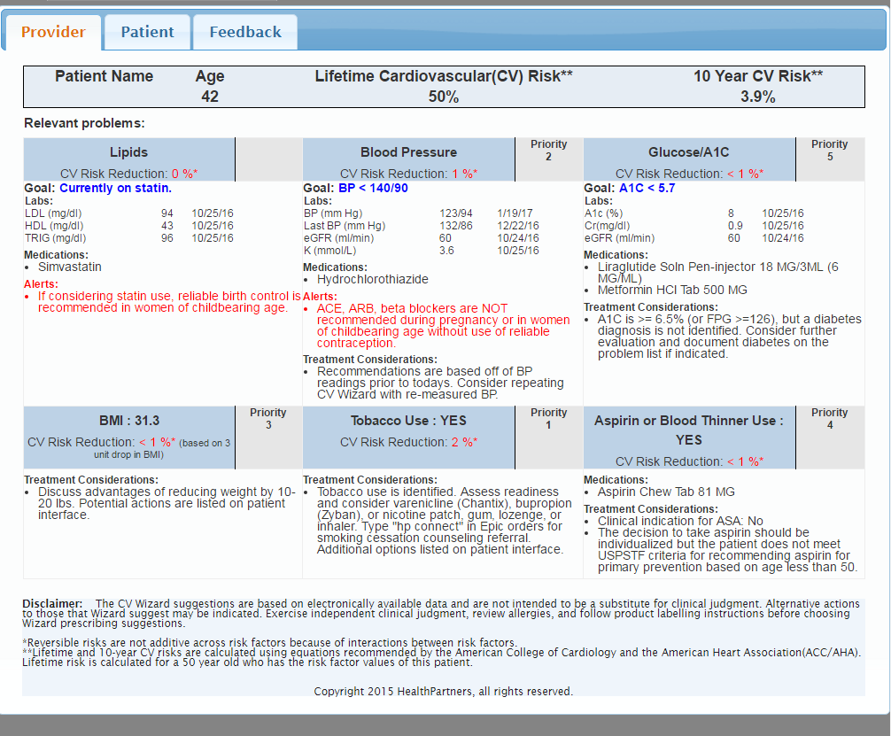
RCT to Reduce CV Risk in Adults with SMI: Provider Sheet

Slide 28
Wizard Platform
Web-based tool that harvests data from the EHR, and for those patients who meet risk thresholds, displays a best practice alert to rooming staff or providers
  Uses active guidelines, dynamic smartsets for orders
  Flexibility in updating algorithms as guidelines change without waiting for Epic approvals and change dates
  Delivers prioritized patient-specific information
  Saves providers 4 minutes and 50 clicks
  93% of providers would recommend
  Use rates: 70-80%

Slide 29
Wizard Versatility
Diabetes, pre-diabetes, CVD
Pediatric Hypertension
Opioid Use Disorder
Cancer Prevention
Appendicitis
Chronic Kidney Disease
Medication Adherence

Slide 30
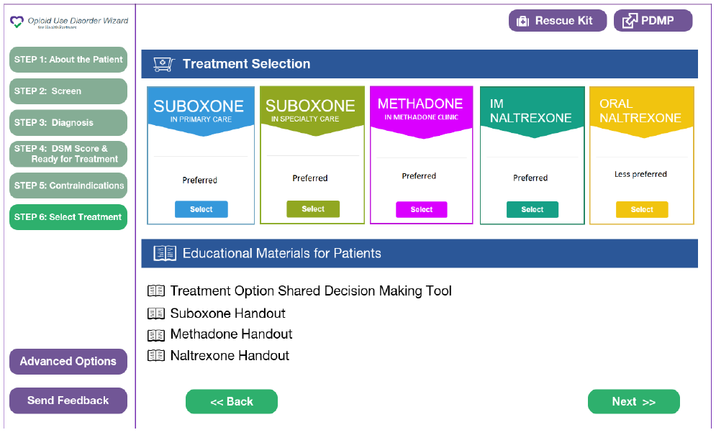

Slide 31
Safer and Targeted Use of Antipsychotics in Youth (SUAY)
Objective: conduct a pragmatic trial of an algorithm to improve antipsychotic medication prescribing to youth with non-psychotic disorders
  Second opinion, care navigation, videoconference psychotherapy
NIMH contract
  KPWA, KPCO, KPNW, Nationwide Children’s Hospital
Currently recruiting patients through an automated best practice alert in the EHR

Slide 32
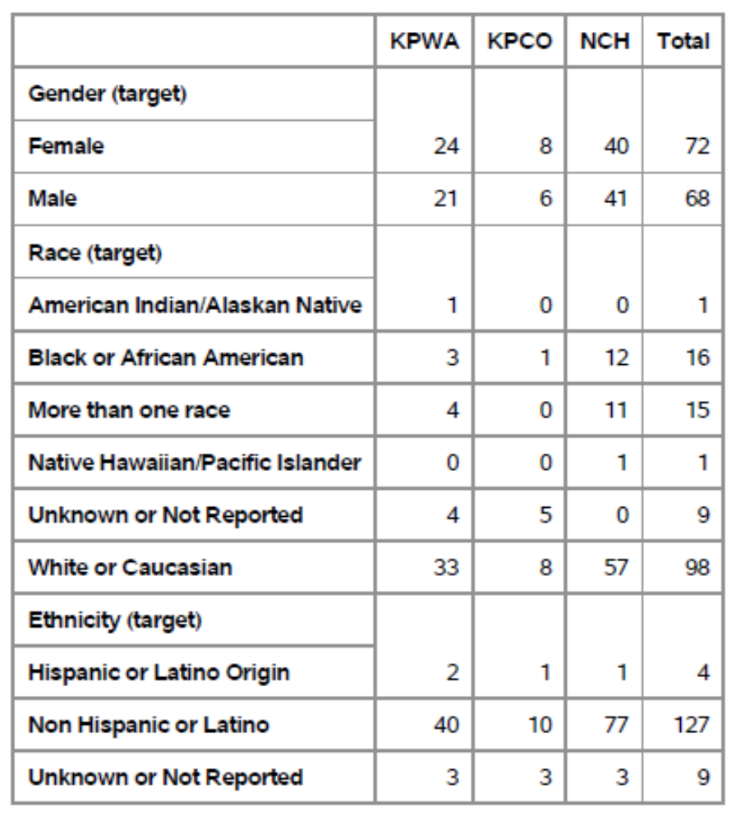
Enrollment
Report as of
10/19
140 youth total
30% racial/ethnic minority youth
51.4% female

Slide 33
Suicide Prevention Outreach Trial
Pragmatic trial of population-based outreach to prevent suicide attempt
4 MHRN sites (KPWA, KPCO, KPNW, HealthPartners)
Automatically enroll all outpatients with PHQ9 item 9 >=2
Randomly assigned to usual care or two interventions:
  Online DBT skills training supported by online coach
  Online/phone care management
Suicide attempts and suicide deaths over 18 mos assessed by health system records

Slide 34
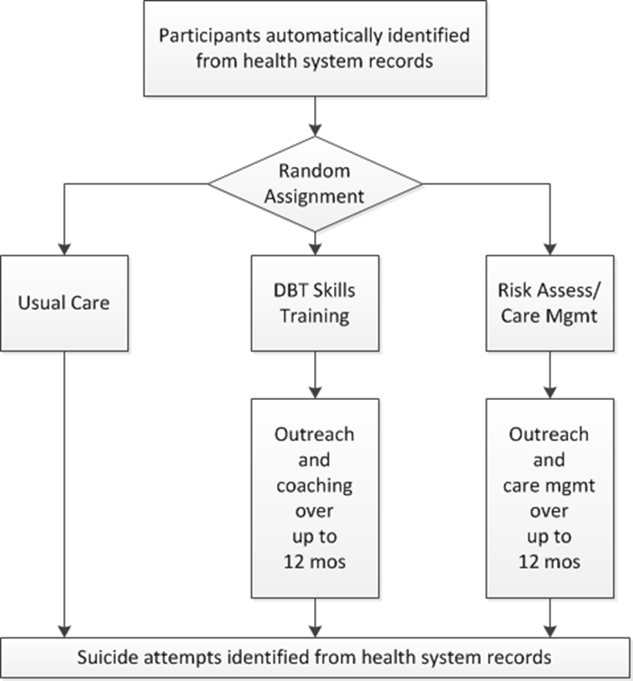
18,900 enrolled
Results expected in early 2020

Slide 35
SPOT Highlights
Modified Zelen design – essential for valid assessment of real-world effectiveness
Established ethical and regulatory framework for real-world trials of prevention in high-risk populations
Enrollment procedures and intervention fully embedded in health system EHRs
New benchmark for trial efficiency ($450/participant)
Ready for extension to pragmatic trials of anticipated glutamate receptor modulator drugs

Slide 36
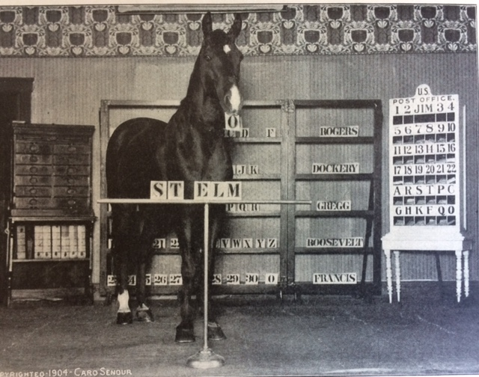
Clever Hans, the Calculating Horse

Slide 37
Even if Clever Hans could do math…
We have better tools for doing math
We have more important work for horses

Slide 38
Stakeholder-driven predictive analytics
Who is the decision-maker we hope to help?
What decision does she need to make?
When and where must she decide?
What data could be available at that point?
What information or prediction would be credible AND useful?

Slide 39
Stakeholder requirements drive methods
Both quantitative:
Piece-wise representation of complex temporal relationships
Over-fitting in clustered data scenarios
Machine learning from distributed data
Prediction accuracy vs. interpretability
Assessment of re-identification risk

Slide 40
And qualitative:
Privacy concerns
Clinician autonomy
Practical workflows
Resource limitations

Slide 41
How it all fits together
Implementation Science
Informatics
Patient engagement
Machine Learning

Slide 42
Personalized treatment: Where we are stuck
Wide range of treatments (and types of treatments)
Modest (and disappointing) average effectiveness
Wide variation in individual response
Variation is largely unpredictable
So treatment selection is largely trial-and-error

Slide 43
Our history of staying stuck
Unconscious conflicts
Neurotransmitter metabolites
Structural imaging
Functional imaging
Genomics

Slide 44
A stubbornly non-learning health system
A disconnected collection of non-randomized crossover trials from which we gain no generalizable knowledge

Slide 45
Why we have stayed stuck
We think it’s like this:
y = b₁x₁ + b₂x₂ + b₃x₃ + b₄x₄ + b₅x₅ ……
When it’s really like this:
… a₄y₄ + a₃y₃ + a₂y₂ + a₁y₁ = b₁x₁ + b₂x₂ + b₃x₃ + b₄x_{4…}
And the left hand side is a lot more complicated

Slide 46
The data we need
Very large samples (100,000 to 1,000,000)
Longitudinal treatment records
Systematic assessment of outcomes
Diverse treatment pathways

Slide 47
The methodologic expertise we need
Specification of treatment exposures from EHR and insurance claims data
Statistical methods for causal inference in the setting of dynamic treatment regimes
Re-usable tools for variable selection or machine learning

Slide 48
And then back to the genetics part
Identify patients with “maximally informative” patterns of treatment response
Outreach to invite contribution of biospecimens

Slide 49
How it all fits together
Causal inference
Informatics
Patient engagement
Machine Learning

